Slide 1
GIT

Slide 2
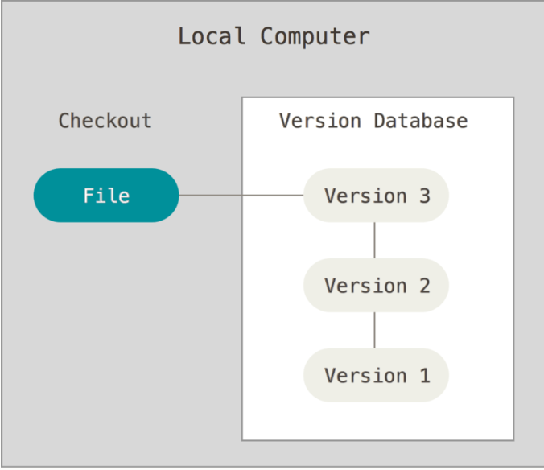
Local Version Control
Version Control
Version control is a system that
record / manages changes to documents, computer programs etc over time. It helps us tracking changes when multiple people work on the same project.

Slide 3
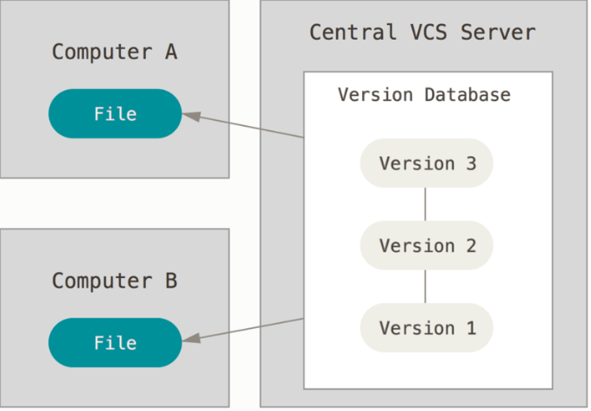
Centralized Version Control Systems

Slide 4
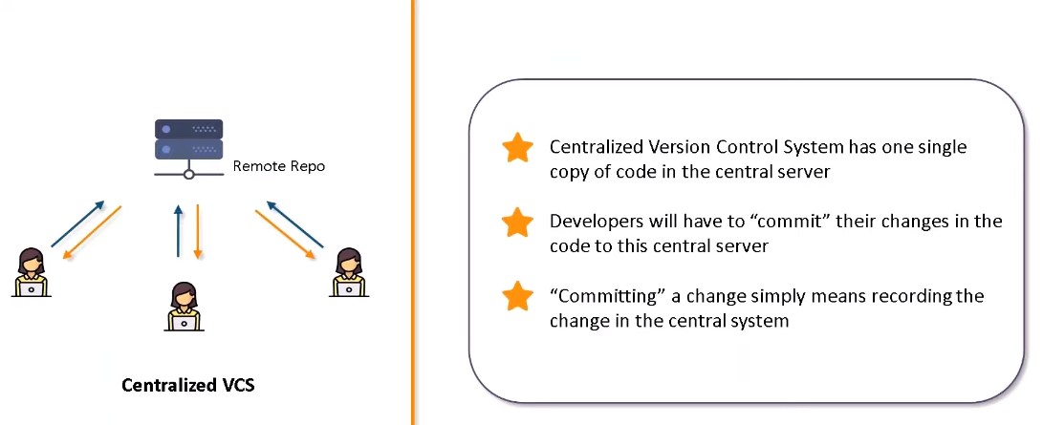
CentralizedVersion Control System

Slide 5
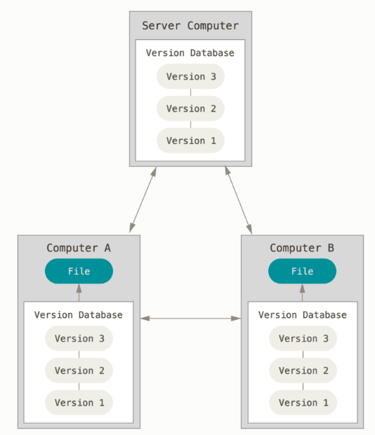
Distributed Version Control Systems

Slide 6
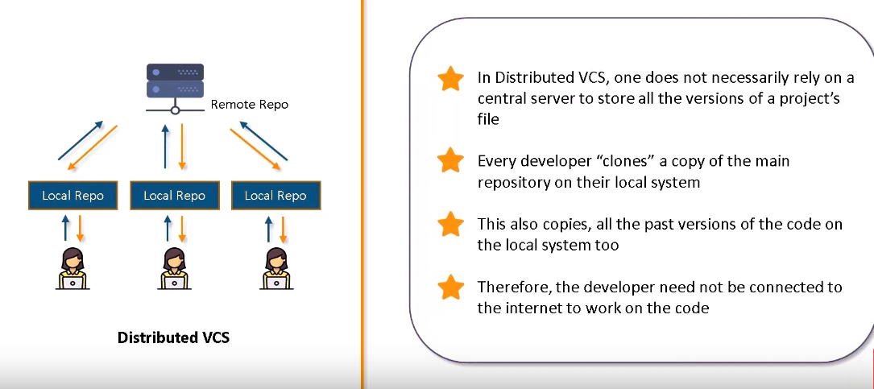
Distributed Version Control System

Slide 7
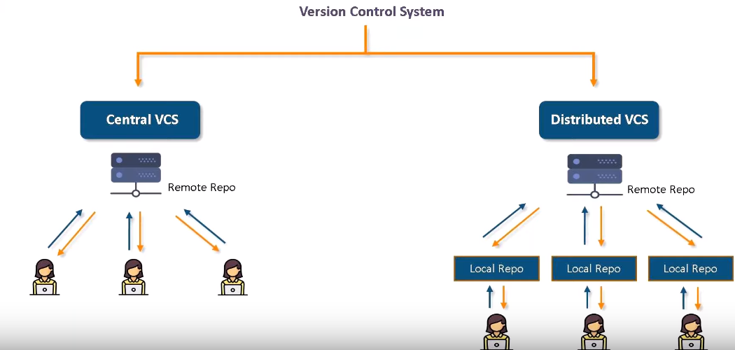
Comparison of VCS and DVCS

Slide 8
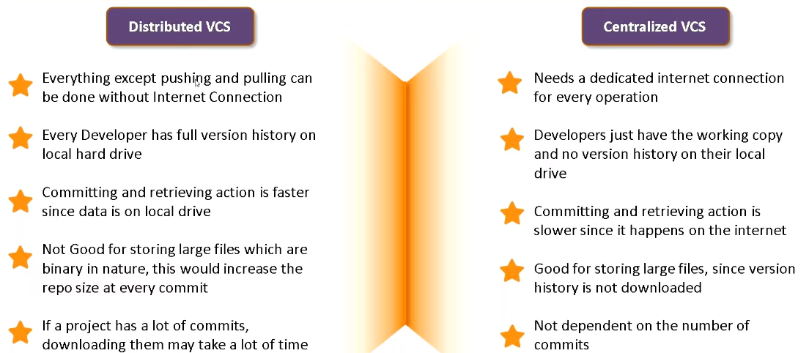
Difference between DVCS and CVCS

Slide 9
What is GIT?
Git is a version-control system for tracking changes in computer files and coordinating work on those files among multiple people. It is primarily used for source-code management in software development, but it can be used to keep track of changes in any set of files.

Slide 10
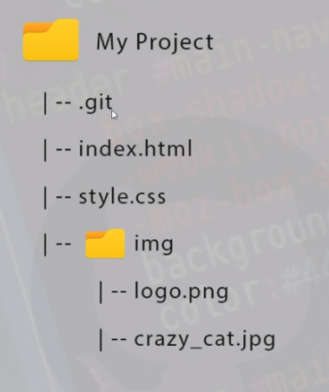
Repositories
A repo is a container for a project you want to track with git (e.g website project)
Can have many different repositories for many different projects on your computer.
Like a project folder which Git tracks the content of for us.

Slide 11
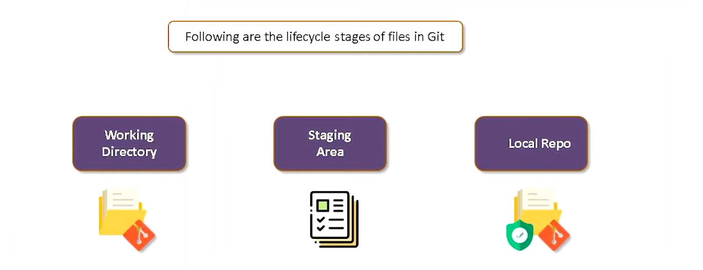
GIT Lifecycle

Slide 12
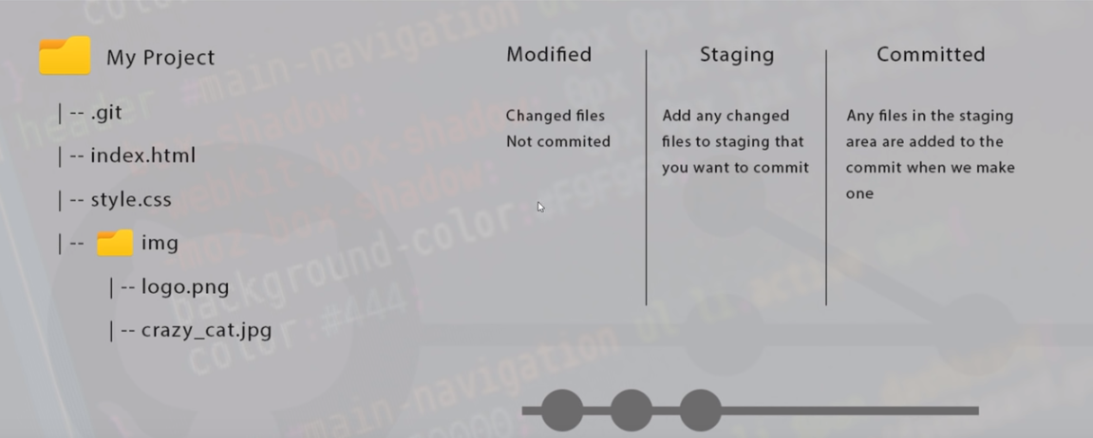
LifeCycle

Slide 13
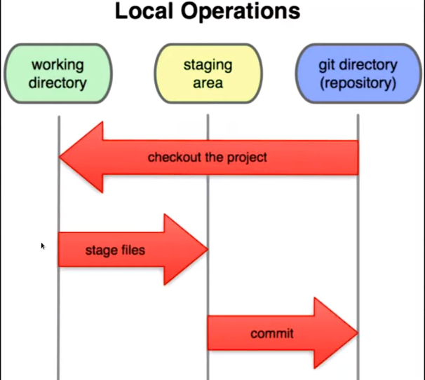
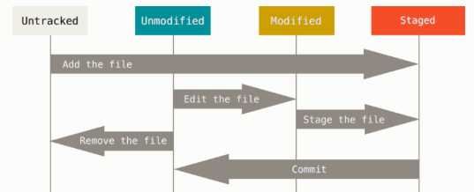
Working Tree & File Status

Slide 14
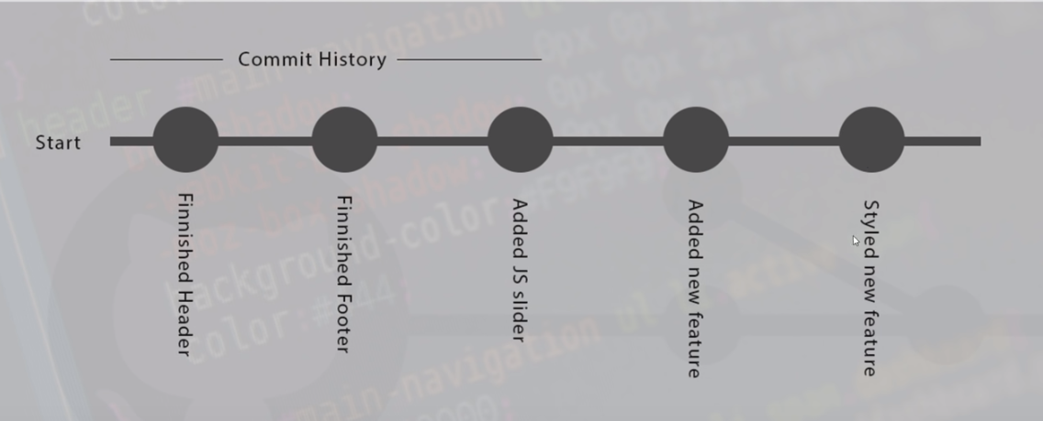
COMMIT

Slide 15
Other DVCS tools
Git is the most popular DVCS tool among all the DVCS tools.
Fossil
Mercurial
BitKeeper
Varacity
CodeVille
Bazaar
Monotone

Slide 16
Installting Git
Windows: https://git-scm.com/download/win
https://desktop.github.com/
Linux:
sudo dnf/apt install git-all
Check the version:
git --version

Slide 17
Global Details
git config --global user.name <username>
git config --global user.email <email id>
git config --global --list
git config --global color.ui “auto”

Slide 18
Common Activity
Create Repository
Making changes
Parallel Development
Syncing Repositories

Slide 19
Git Basic Commands
You can create a repository using the command git init. Navigate to your project folder and enter the command git init to initialize a git repository for your project on the local system.
mkdir gitRepo
Create two files test1.txt and test2.txt in the gitRepo
Initialize the gitRepo
git init
Once the directory has been initialized you can check the status of the files, whether they are being tracked by git or not, using the command.
git status

Slide 20
Git Basic Commands
Once the file has been created or changed we have to stage the file in our repository. We can stage the file using the command
git add <.> Or <FileName>
Once the files or changes have been staged , we are ready to commit them in our repository. We can commit the file using the command
git commit –m “<custom message>”

Slide 21
Git Basic Commands
Once everything is ready on our local, we can start pushing our changes to the remote repository copy your repository link and paste it in the command.
git remote add origin “URL to repository”
To push the changes to your repository, enter the command git push origin <branch-name> and hit enter. In our case branch is master , hence git push origin master. This command will then prompt for username and password, enter the values and hit enter.
git push origin master
After this the local repository is now synced with the remote repository on github.
To get the latest code to other developer, enter the command git clone with the http URL for the repository.
git clone “URL to repository”
git clone “URL to repository” foldername

Slide 22
Git Basic Commands
Create branch to work with multiple developers.
git branch <branch_name>
List all the branches
git branch
git branch -a
Delete the branch
git branch –D <branch_name>
git branch –d <branch_name>
Create and checkout
git checkout –b <branch-name>
Change the branch
git checkout <branch_name>
git checkout HEAD~<number> <fileName>
To push the change to branch
git push origin <branch_name>

Slide 23
Git Basic Commands
Want to save the work without committing the code. This can helpful when you want to switch branches, but do not want to save your work to your git repository. To stash your staged files without committing just type in git stash. If you want to stash your untracked files as well, type git stash –u and once you are back and want to retrieve working, type in git stash pop.
git stash
git stash –u
git stash pop
Reverting the changes in the repository. Get all the information in the log command.
git log
git log --n 2
git log --stat
git log --oneline
git log --author=<“author name”>
git log --since=‘3 days ago’
git revert <commit id>

Slide 24
Git Basic Commands
Check the difference between two version of a file.
git diff <commit-id of version X> <commit-id of version Y>
git diff
git diff --staged
Git diff HEAD~3

Slide 25
Git Basic Commands
Git-remote – Managed set of tracked repositories
git remote –v
git remote add mycentral <URL>
Pull Request : It’s a merge operation which also needs a review done by person.
Merge: Applying the changes to the master branch or other branch

Slide 26
.gitIgnore Files
# ignore all .a files
*.a
# but do track lib.a, even though you're ignoring .a files above
!lib.a
# only ignore the TODO file in the current directory, not subdir/TODO
/TODO
# ignore all files in any directory named build
build/
# ignore doc/notes.txt, but not doc/server/arch.txt
doc/*.txt
# ignore all .pdf files in the doc/ directory and any of its subdirectories
doc/**/*.pdf

